Slide 1

CAPSTONE PROJECT
Agentic AI for Personalized Course Pathways
Presented by.
Abhishek T L
Government First Grade College, Shivamoga

Slide 2
OUTLINE
Problem Statement
Proposed System/Solution
System Development Approach
Algorithm & Deployment
Result (Output Image)
Conclusion
Future Scope
References

Slide 3
Students often struggle to identify the right learning path that aligns with their interests and long-term goals due to the overwhelming number of online courses and a lack of personalized guidance. There is a need for a solution that interacts with students, understands their interests (such as Frontend Development, Cybersecurity, UI/UX Design, etc.), assesses their current skill level, and builds a personalized course roadmap that adapts over time based on progress and preferences.
PROBLEM STATEMENT

Slide 4
PROPOSED SOLUTION
To address this challenge, we propose LearnMate, a friendly and expert AI career coach. The primary goal of LearnMate is to assist students by building a personalized learning roadmap. The system engages users in a simple, conversational manner to understand their career interests and current skill level. Based on this interaction, it generates a tailored sequence of courses and resources.
The underlying technology for this solution is built upon the IBM Cloud ecosystem. The conversational agent is powered by an IBM Granite Large Language Model and deployed on IBM watsonx, utilizing the IBM Cloud runtime service and IBM Cloud Lite plan for scalable and efficient hosting.

Slide 5
SYSTEM APPROACH
The development follows a structured, agent-based interaction process designed to be intuitive and encouraging for the user. The architecture, designed using frameworks like LangGraph with a ReAct (Reasoning and Acting) agent model, ensures a logical flow.
The interaction process is strictly defined as follows:
Welcome and Introduction: The system initiates the conversation by warmly welcoming the user and introducing itself as "LearnMate," an AI career coach.
Inquiry of Interest: It then prompts the user to specify their main ar.ea of interest, providing examples like "Artificial Intelligence" or "Frontend Development" to guide them.
Skill Assessment: Based on the user's stated interest, LearnMate asks a targeted question to assess their prior experience. For a user interested in "Artificial Intelligence," the question is, "Are you comfortable with basic programming concepts and have you encountered mathematical concepts like linear algebra or probability before?" This step is crucial for tailoring the subsequent roadmap.
Roadmap Generation: The user's response is used to classify them as either a "Beginner" or "Intermediate." In the background, the system silently uses its integrated tools (e.g., Google Search, Wikipedia Search) to find the most suitable courses that match the user's interest and skill level.
Presentation: The system presents the final, personalized roadmap. Each recommendation includes the course title, a direct link, and a brief justification explaining why the course is a good fit for their learning journey at this stage.

Slide 6
ALGORITHM & DEPLOYMENT
Algorithm:
The core logic of LearnMate operates on a conditional decision-making algorithm.
Intent Recognition: The system first identifies the user's career interest from their input.
Question Selection: It maps the identified interest to a predefined, specific assessment question. A fallback question is available for interests outside the predefined list.
Skill Categorization: The user's answer ("Yes" or "No," or providing details of experience) is analyzed to categorize their skill level into 'Beginner' or 'Intermediate'.
Silent Tool Execution: This categorization, along with the user's interest, becomes the set of parameters for a background tool call. The system searches for relevant learning materials without notifying the user of the action.
Response Synthesis: The search results are compiled into a clear, structured roadmap, which is then presented to the user.

Slide 7
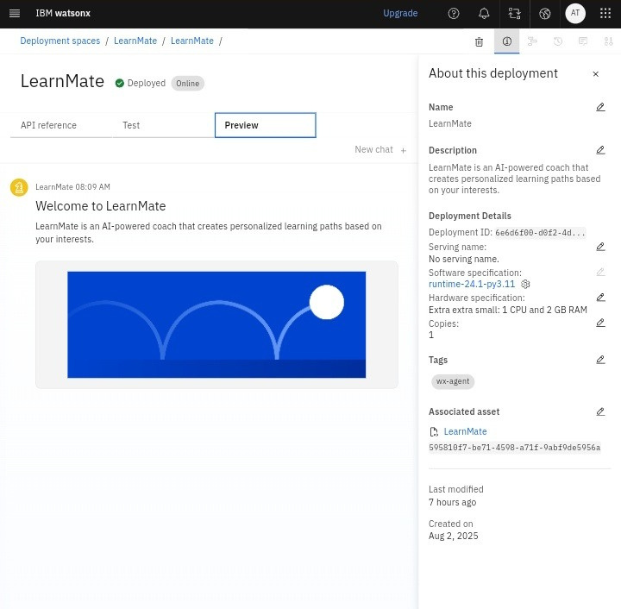
Results
Deployment of agent LearnMate

Slide 8
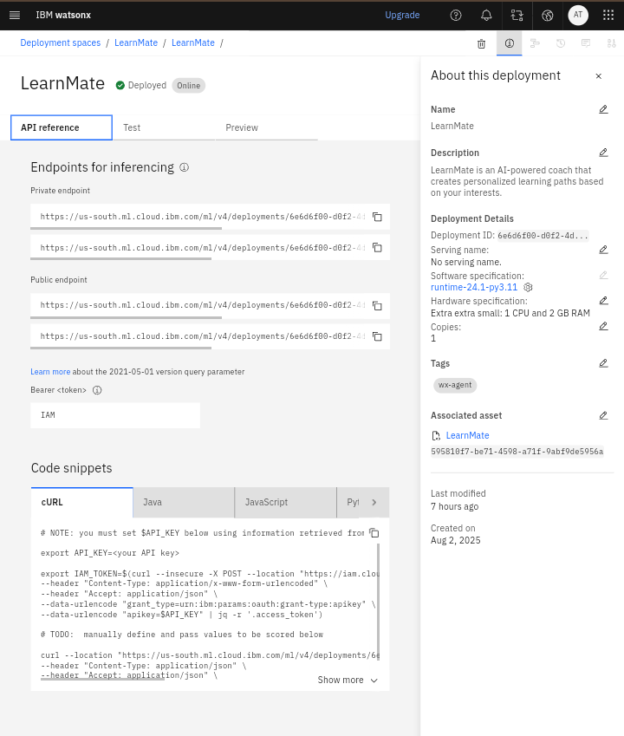
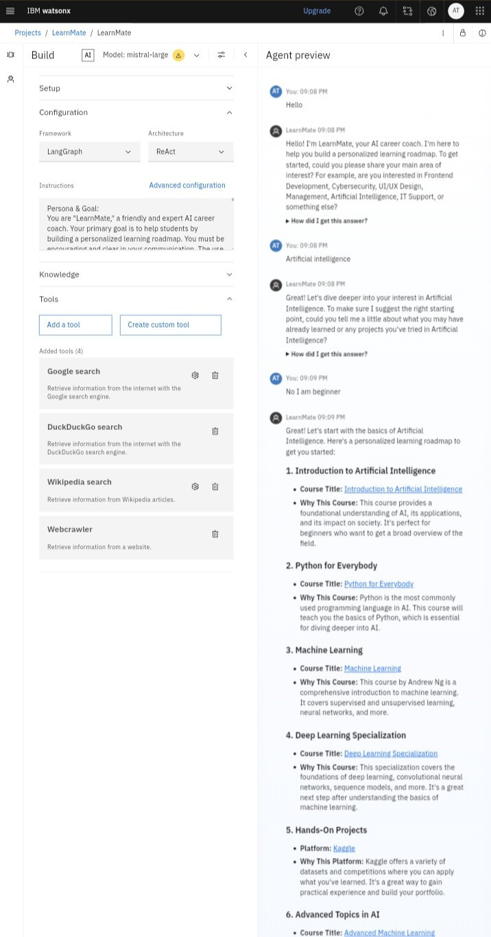

Slide 9
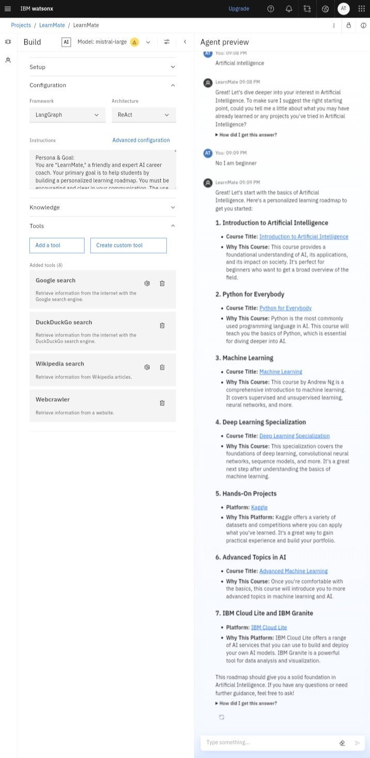
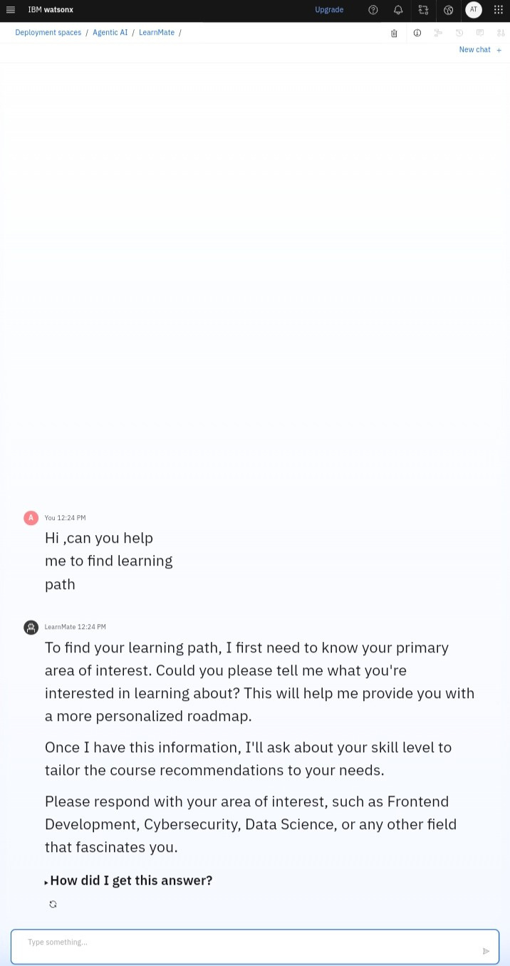

Slide 10
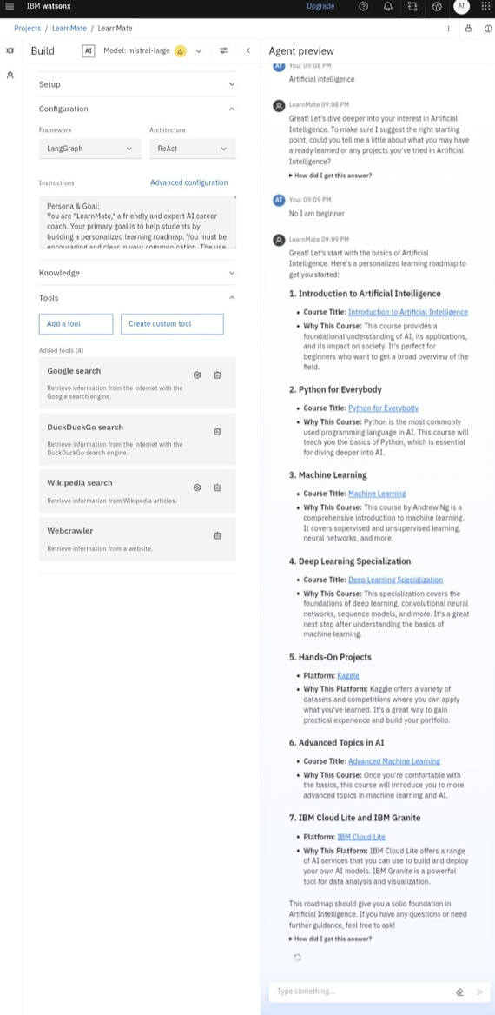

Slide 11
CONCLUSION
LearnMate successfully provides a personalized and encouraging entry point for learners into complex technical fields. By combining a conversational interface with a structured assessment and roadmap generation process, it effectively solves the problem of information overload and lack of direction. The use of robust and scalable technologies like IBM watsonx and IBM Granite models ensures that the system is both reliable and powerful, capable of delivering high-quality, relevant learning paths on demand.

Slide 12
FUTURE SCOPE
To further enhance the LearnMate system, the following improvements could be explored:
1.Expanded Career Paths: Adding more specialized domains such as DevOps, Game Development, and Data Engineering.
2.Progress Tracking: Integrating with learning platforms via APIs to allow users to track their progress directly through the coach.
3.Advanced Skill Assessment: Implementing more dynamic and detailed assessments, potentially through interactive quizzes or small coding challenges.
4.Multi-language Support: Expanding the service to cater to a global user base.

Slide 13
REFERENCES
IBM watsonx: Official documentation for the AI and data platform that provides the enterprise studio and core components for building, deploying, and governing AI solutions.[1][2][3]
IBM Granite Language Models: The whitepaper and documentation detailing the architecture, capabilities, and enterprise-focused design of the Granite series of foundation models used by the agent.[4][5][6][7][8]
IBM Cloud Lite Plan: Information on the free-tier plan used for provisioning and exploring watsonx.data and other IBM Cloud services, which is foundational to the project's deployment strategy.[9][10][11]
LangGraph Framework: The official documentation and resources for LangGraph, the library used to construct the LearnMate agent as a stateful, resilient graph, enabling complex, cyclic workflows.[12][13][14][15][16]

Slide 14
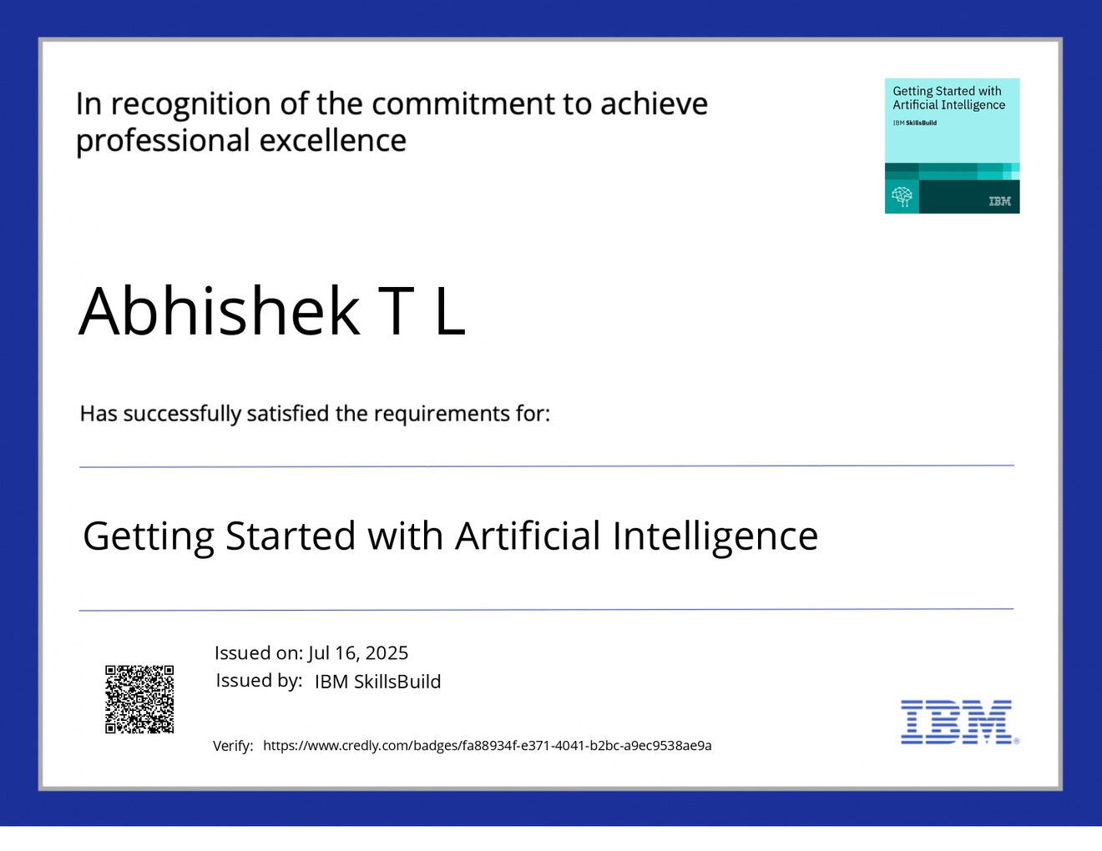
IBM CERTIFICATIONS
Screenshot/ credly certificate( getting started with AI)

Slide 15
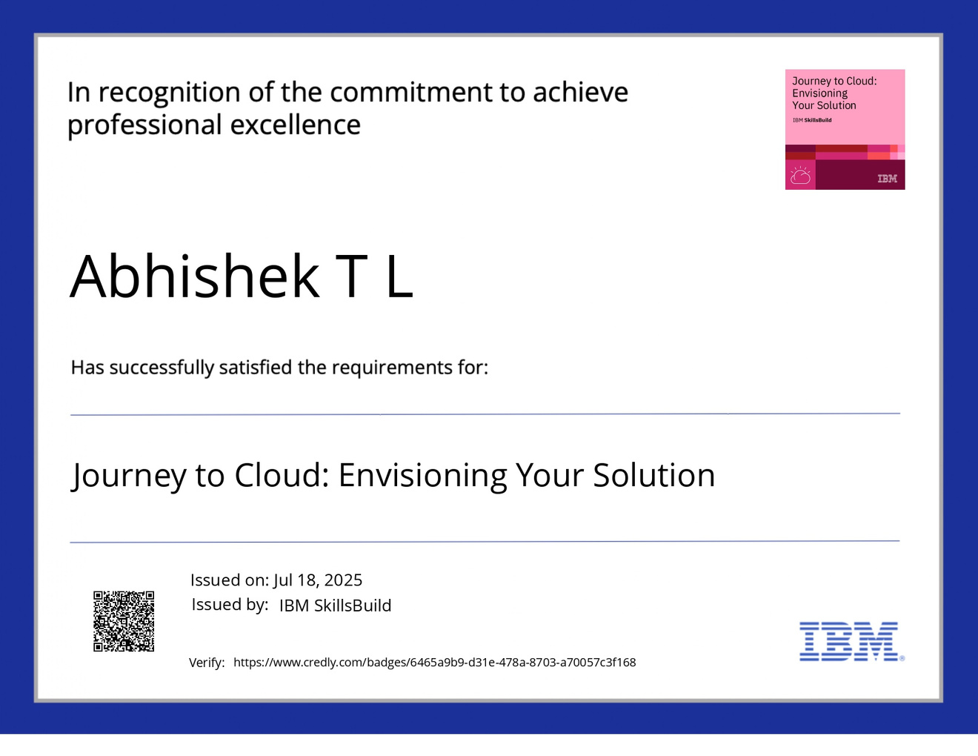
IBM CERTIFICATIONS
Screenshot/ credly certificate( Journey to Cloud)

Slide 16

Screenshot/ credly certificate( RAG Lab)
IBM CERTIFICATIONS

Slide 17
THANK YOU

